Slide 1
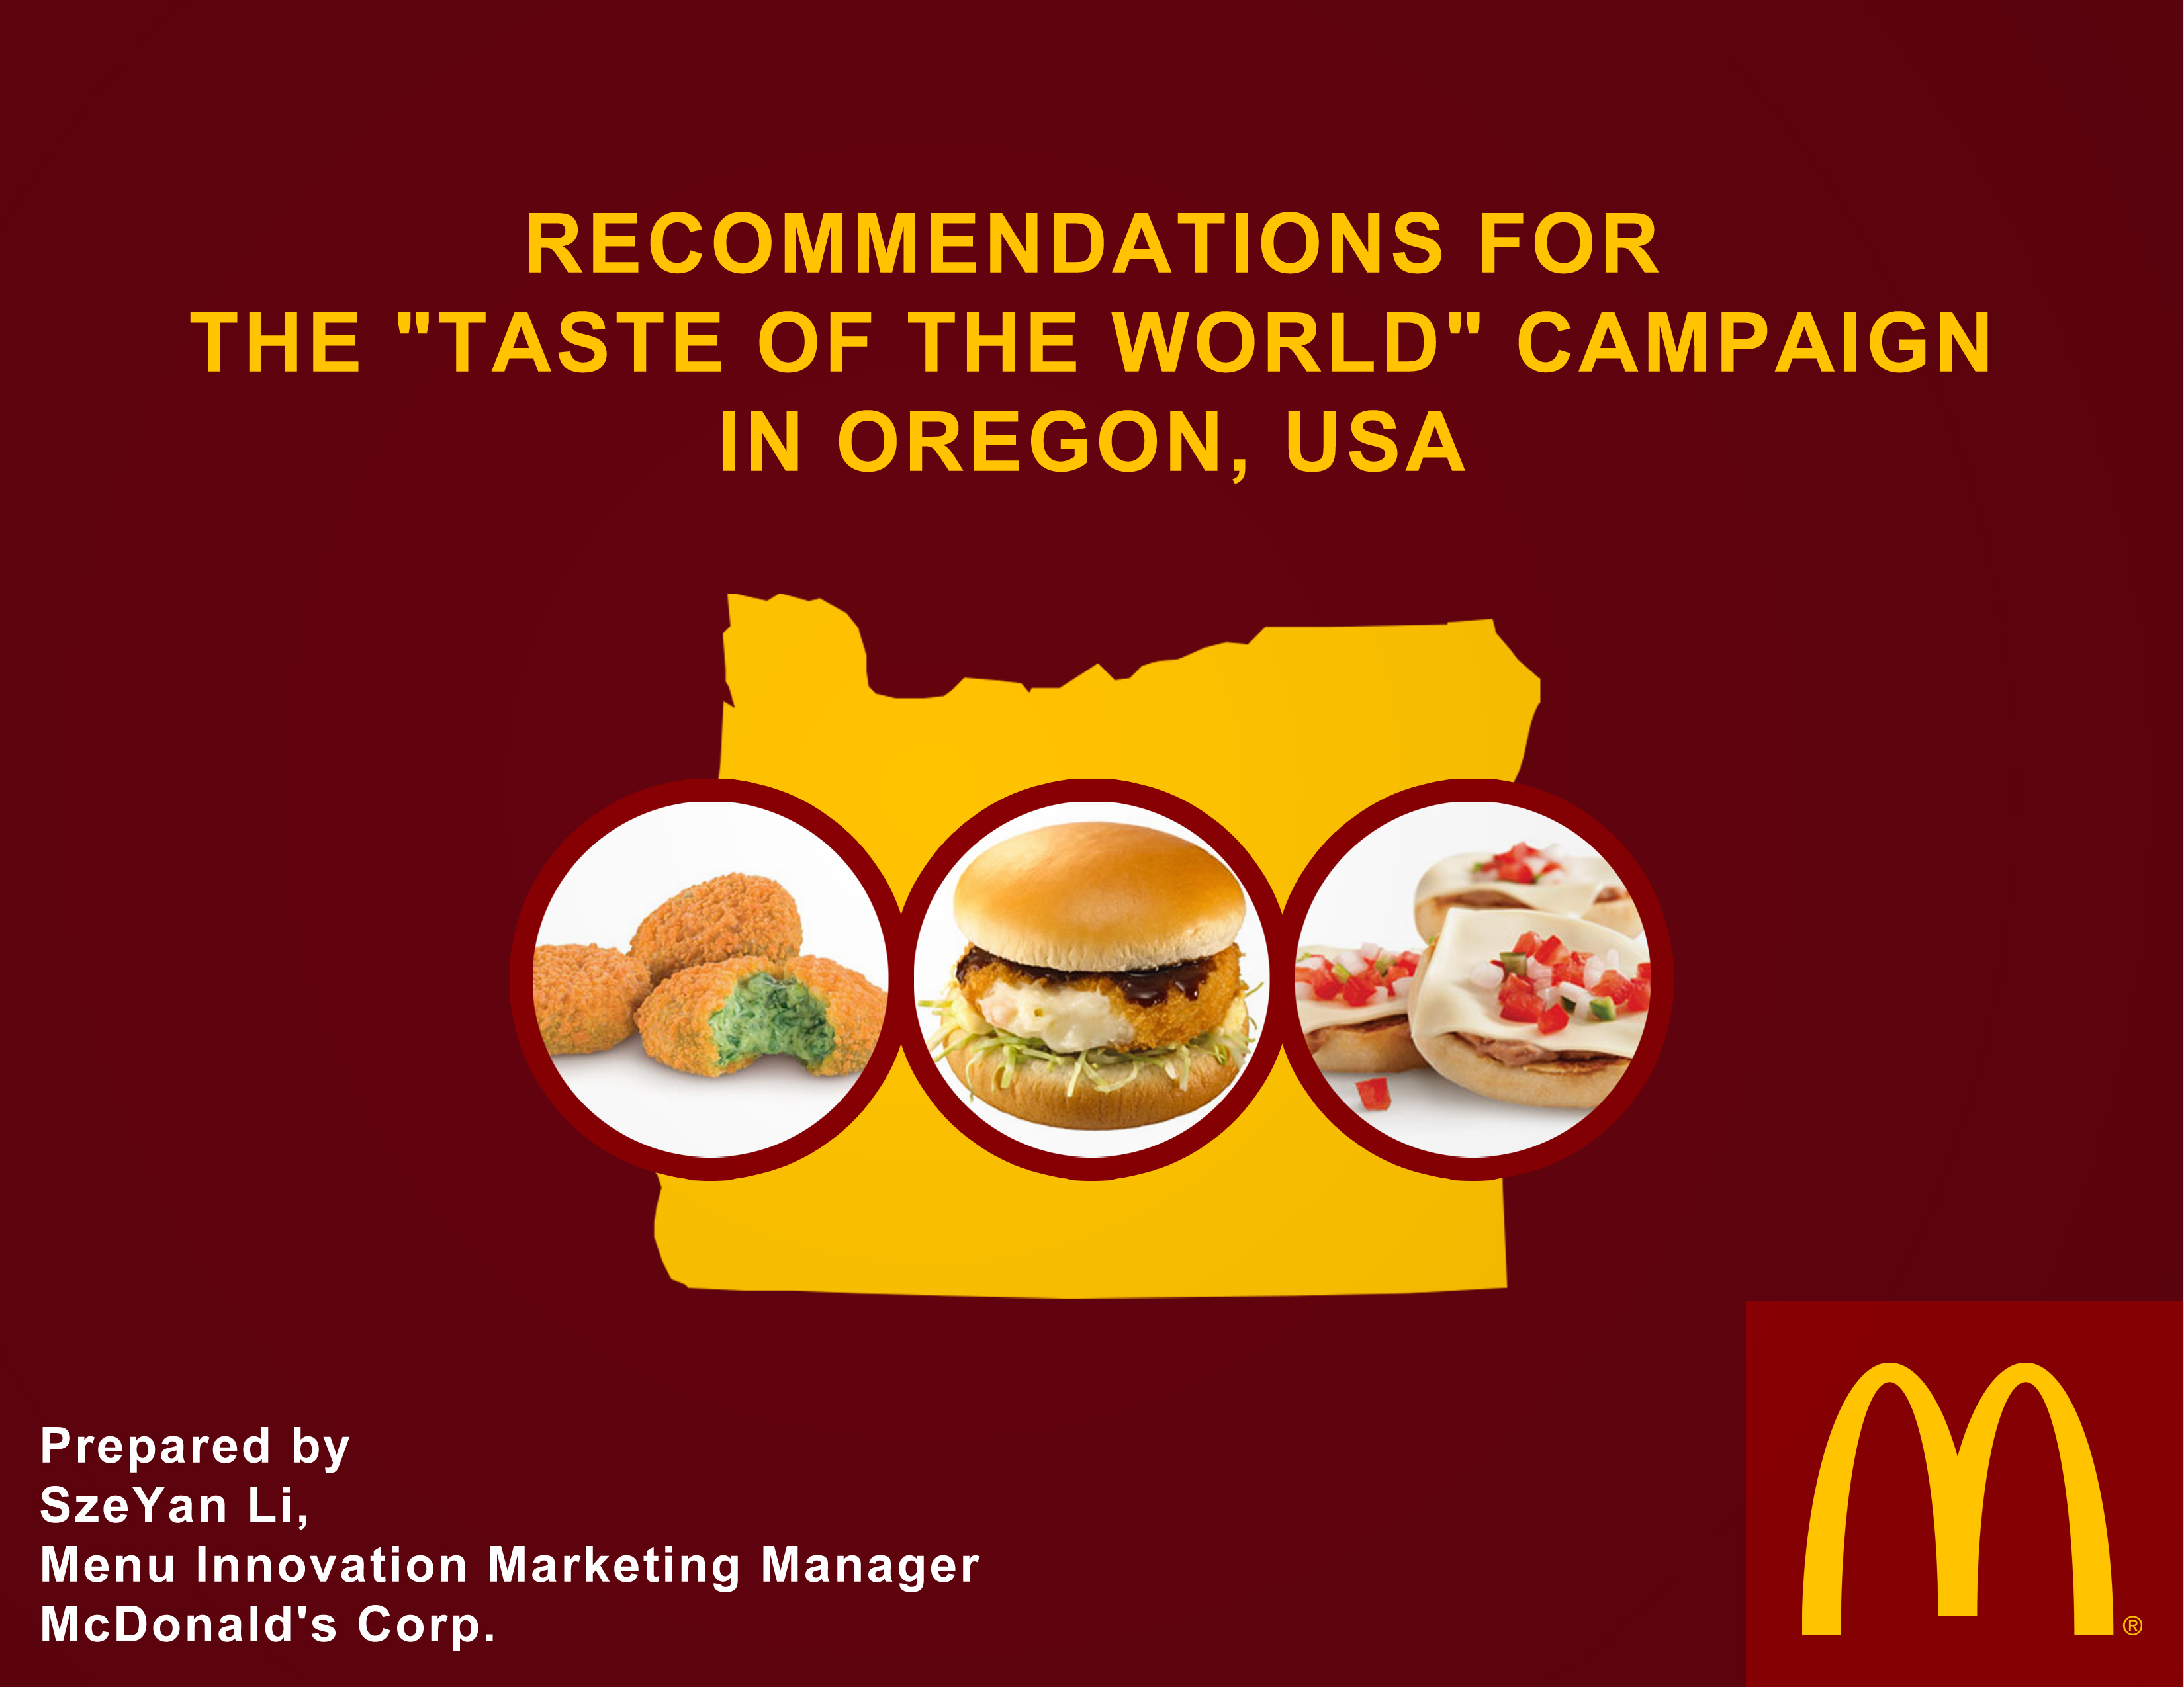

Slide 2
Today’s Topics
Introducing “Taste of the World” Campaign
An Analysis on “What is Oregon?”
The Three Menu Items to Feature

Slide 3
34,000 restaurants worldwide
118 countries
1.8 million employees
How does McDonald’s maintain its success?
Through innovation!

Slide 4
Example: McDonald’s Italy
In 2008 McDonald’s worked with Italian farmers
Added Parmigiano Reggiano Cheese to its burgers
Profit? Sales increased by 15% that year!
So why not do that here?

Slide 5
“Taste of the World” Campaign
Recent studies show Americans’ increasing interest and receptiveness towards ethnic foods
The campaign will debut in the state of Oregon
Based on its success, McDonald’s will decide whether to expand this campaign into a national venture
Marketing team is tasked with:
Analyzing aspects of Oregon
Finding three menu items from McDonald’s international menus to feature in the “Taste of the World” campaign

Slide 6
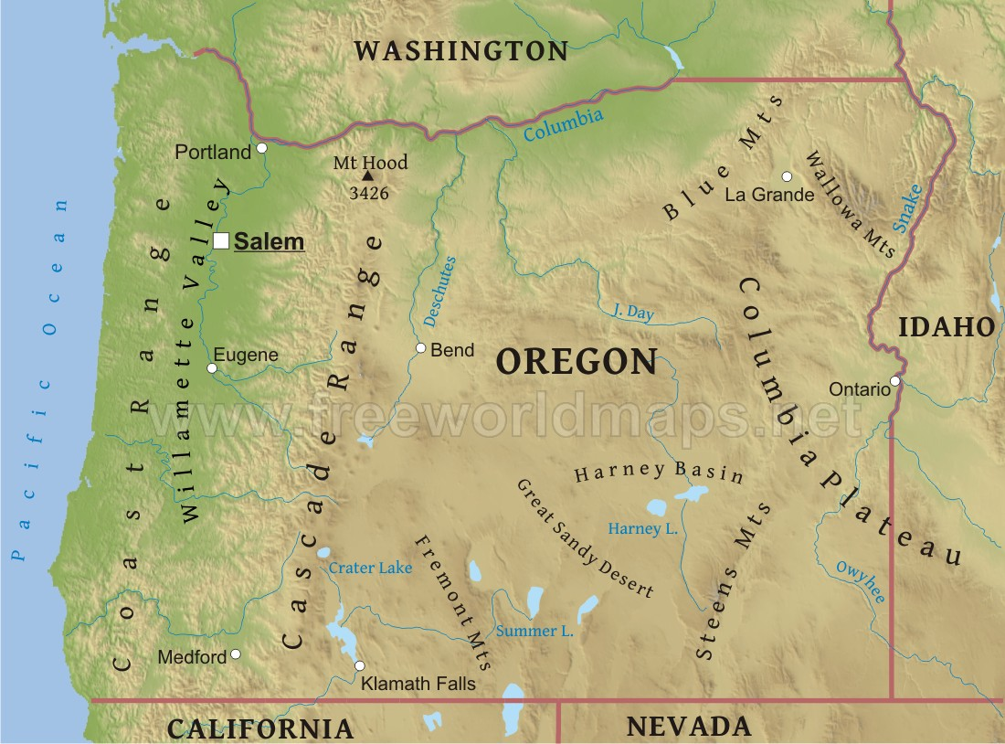
Oregon
Climate differs between the East and West of the Cascades
250 different products grown
Rogue Creamery’s Oregon Blue cheese
Caught 49.1 million pounds of pink shrimp in 2012

Slide 7
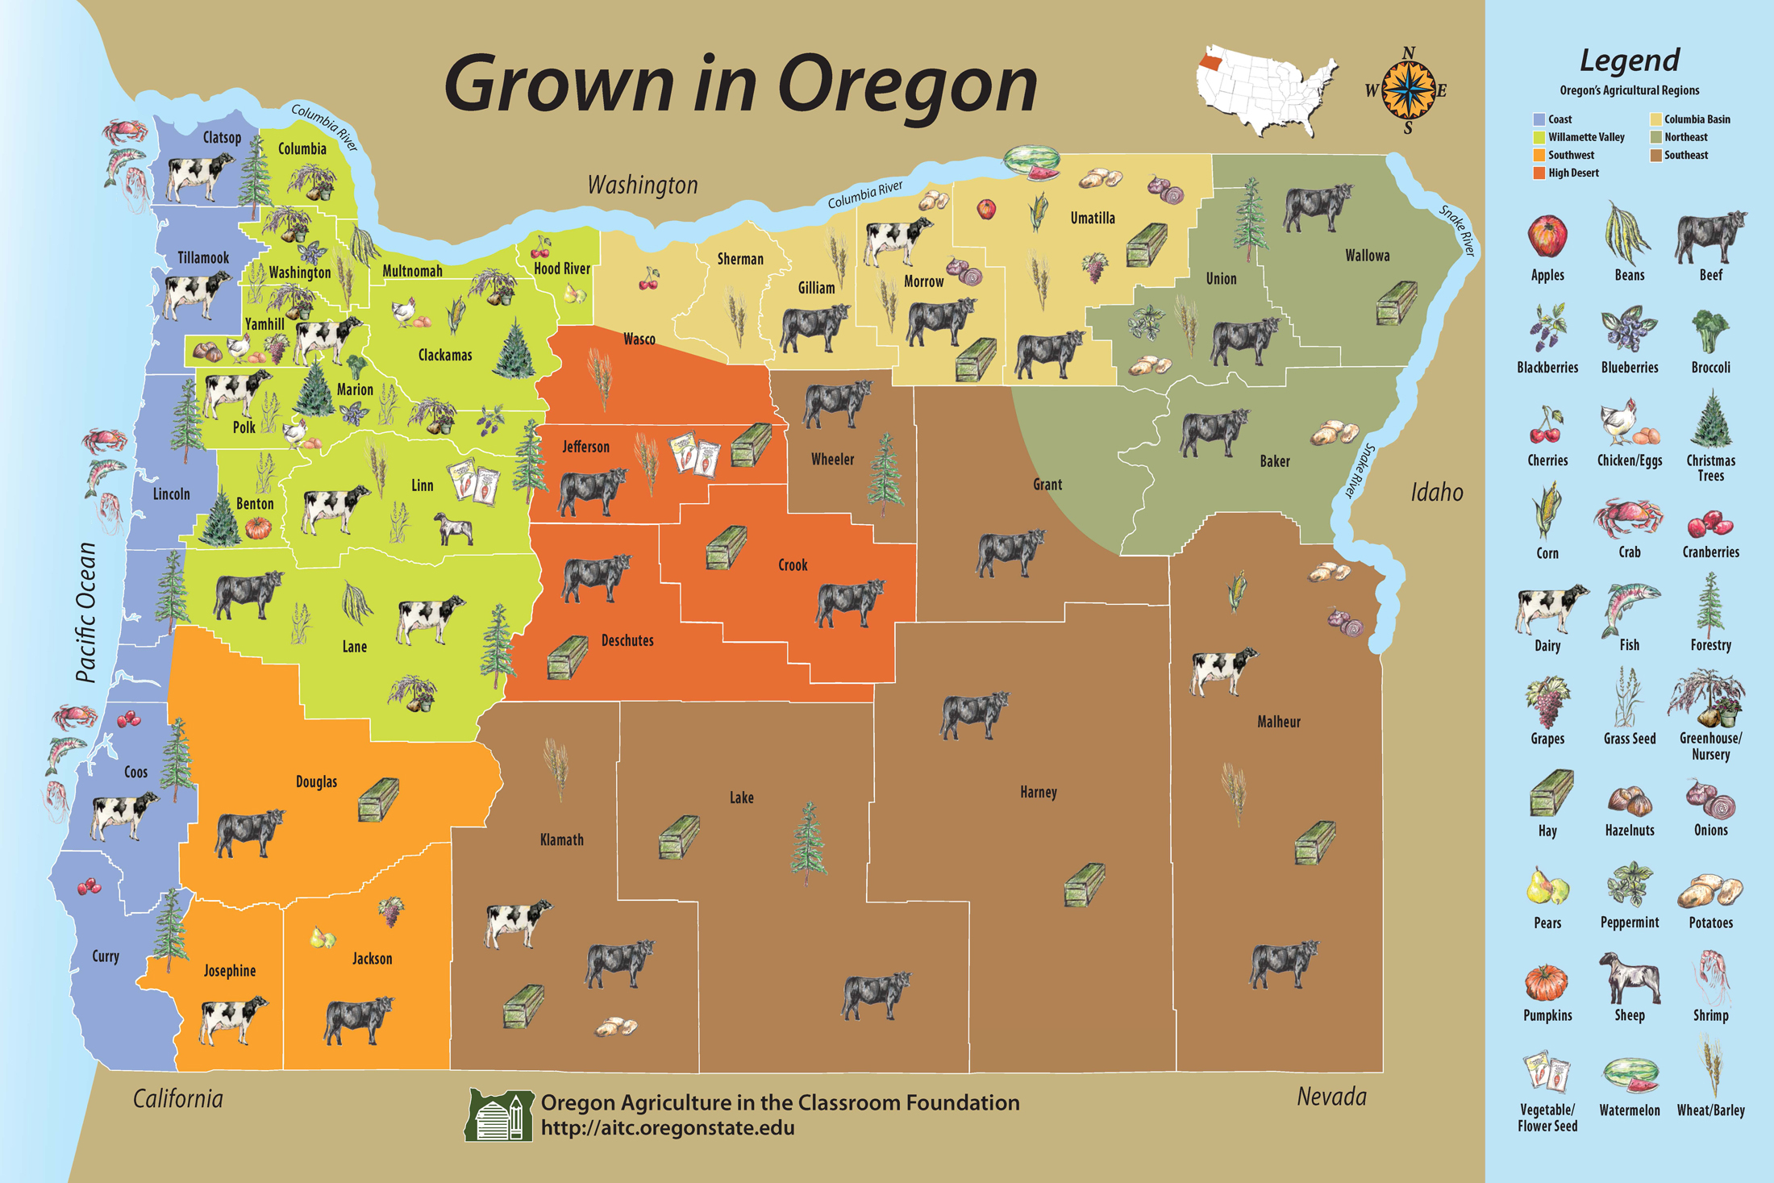

Slide 8
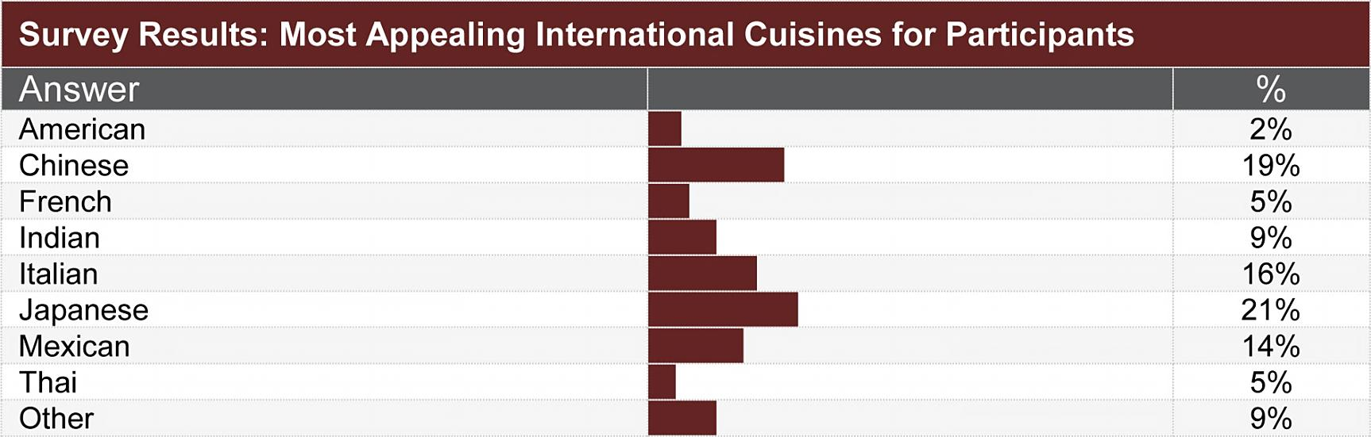
Survey Given to 200,000 Oregonians
Majority consumed red meats, white meats, seafood
24% participants were vegetarians of some kind
69% percent responded positively towards the possibility of ethnic food choices being added to their McDonald’s menus
Wanted to see either a new breakfast, snack/appetizer, or lunch/dinner option

Slide 9
The Criteria
Meal Options
Breakfast
Snack or Appetizers
Lunch or Dinner
(Desert)
Cuisines
Japanese (or Chinese)
Mexican
Local Ingredients
Seafood
Cheeses
(Berries)
Italian

Slide 10
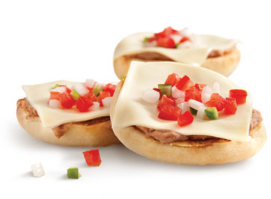
#1 McDonald’s Mexico’s
McMollettes
Official Name: McMolletes
Origin: McDonald’s Mexico
Meal Option: Breakfast
Main Ingredients: Refried beans, cheese,
pico de gallo
Suggested Price: $2.29

Slide 11
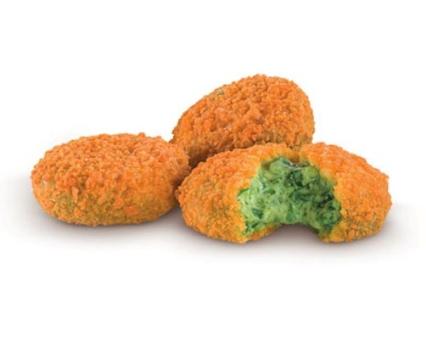
#2 McDonald’s Italy’s
Spinach and Parmesan Cheese Nuggets
Official Name: Crocchette di Spinaci Parmigiano Reggiano
Origin: McDonald’s Italy
Meal Option: Snack or Appetizer
Main Ingredients: Spinach, Parmesan Cheese
Suggested
Price (9 pcs): $4.95

Slide 12
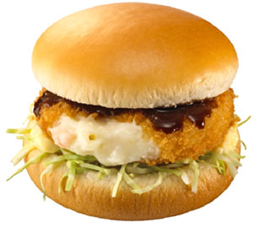
#3 McDonald’s Japan’s
Korokke or Gurako Burger
Official Name: Gurako or Korokke Burger
Origin: McDonald’s Japan
Meal Option: Lunch or Dinner
Main Ingredients: Pink Shrimp, Potatoes, Cheese, Cabbage
Suggested Price: $2.75

Slide 13


